Slide 1

Group 13
Axelle Van Langenhove
Lotte Cammu
Mathias De Vulder
Jolan Vantroyen
Thibault Ledegen
27/01/2026

Slide 2


PRESENTATION AGENDA
OUR FEATURES
TRAILTRIBE IDEA
Presentation of the most important
features implemented in our
application
QUESTIONS
Explanation of Toon Teugels’ idea of TrailTribe
Questions about our application,
presentation or database models
TRAVELER / ORGINAZER JOURNEY
DEMONSTRATION
The application from both traveler and organizer perspectives
Demo of our application and the implemented features

Slide 3
TRAILTRIBE IDEA
The main idea
Reversing the traditional travel model: The traveler is central, not the catalog.
Profile Intake
Comprehensive, interactive tests gather crucial data about travel style and personality.
The Result
A custom-made dream trip with the perfect, like-minded group.
Smart Matching
Linking profiles based on 'vibe' and age to guarantee an immediate 'click'.

Slide 4
TRAVELER JOURNEY
01
02
03
04
Create account
Intake
Get matched
Trip
Create an account by entering your email address.
Enjoy doing a fun intake about your traveling interests and personality.
Our smart matching system groups you with travelers who share your interests and travel style.
An experienced organizer selects the perfect trip for your group.

Slide 5
ORGANIZER JOURNEY
01
02
03
04
Create account
Create a trip
Manage groups
Link a trip
Create an account by entering your email address.
Create a trip by defining its details: destination, content, price per person, deposit, available places, and start and end dates.
Groups can be generated automatically and linked to the people with the highest matching percentage, based on data from the travelers' intake.
Once groups are generated, trips are assigned by a professional organizer based on travelers’ intake data, ensuring a trip that matches their ideal preferences.

Slide 6

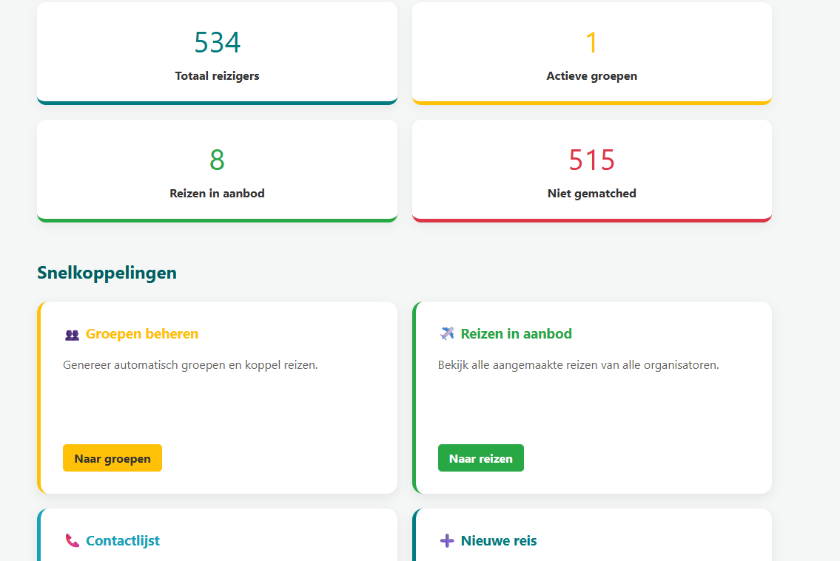

​
OUR MAIN FEATURES
Become a User / Organizer
Organizer dashboard
Intake
Matching algorithm
Grouping algorithm
Notes:
DIA JOLAN

Slide 7
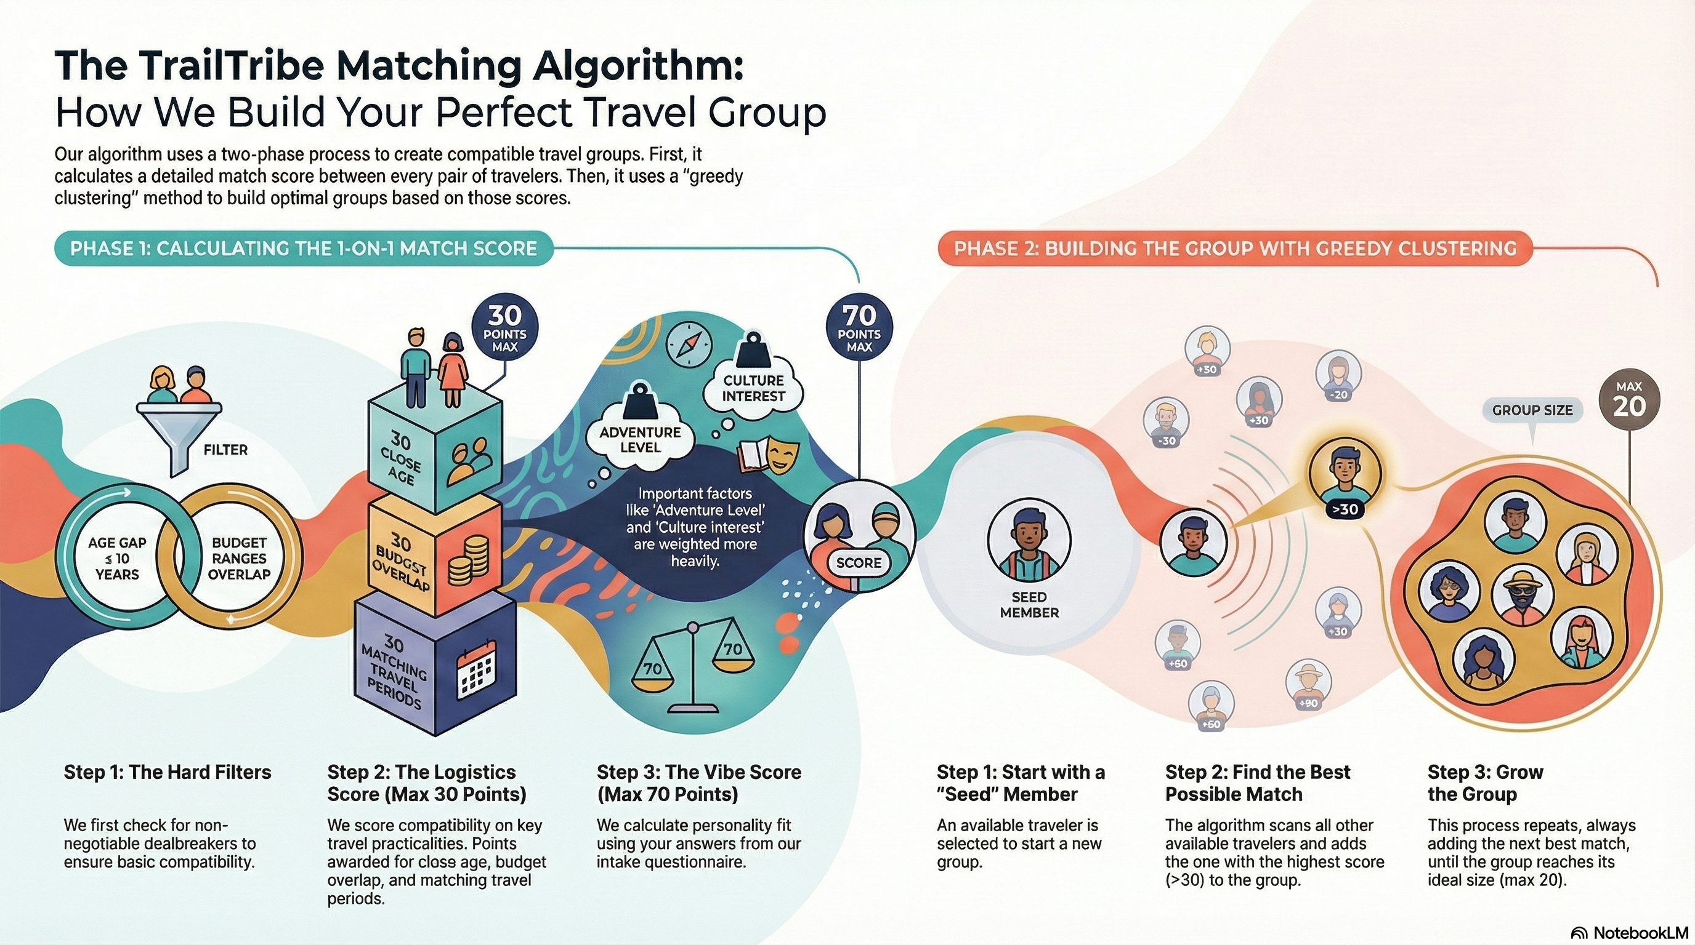
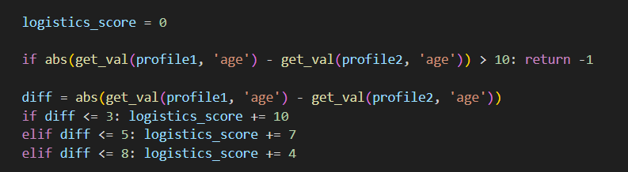
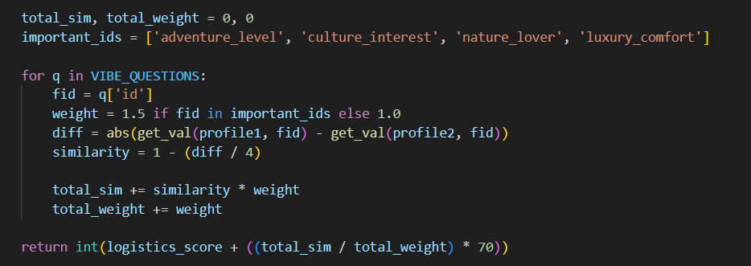
Notes:
DIA JOLAN

Slide 8
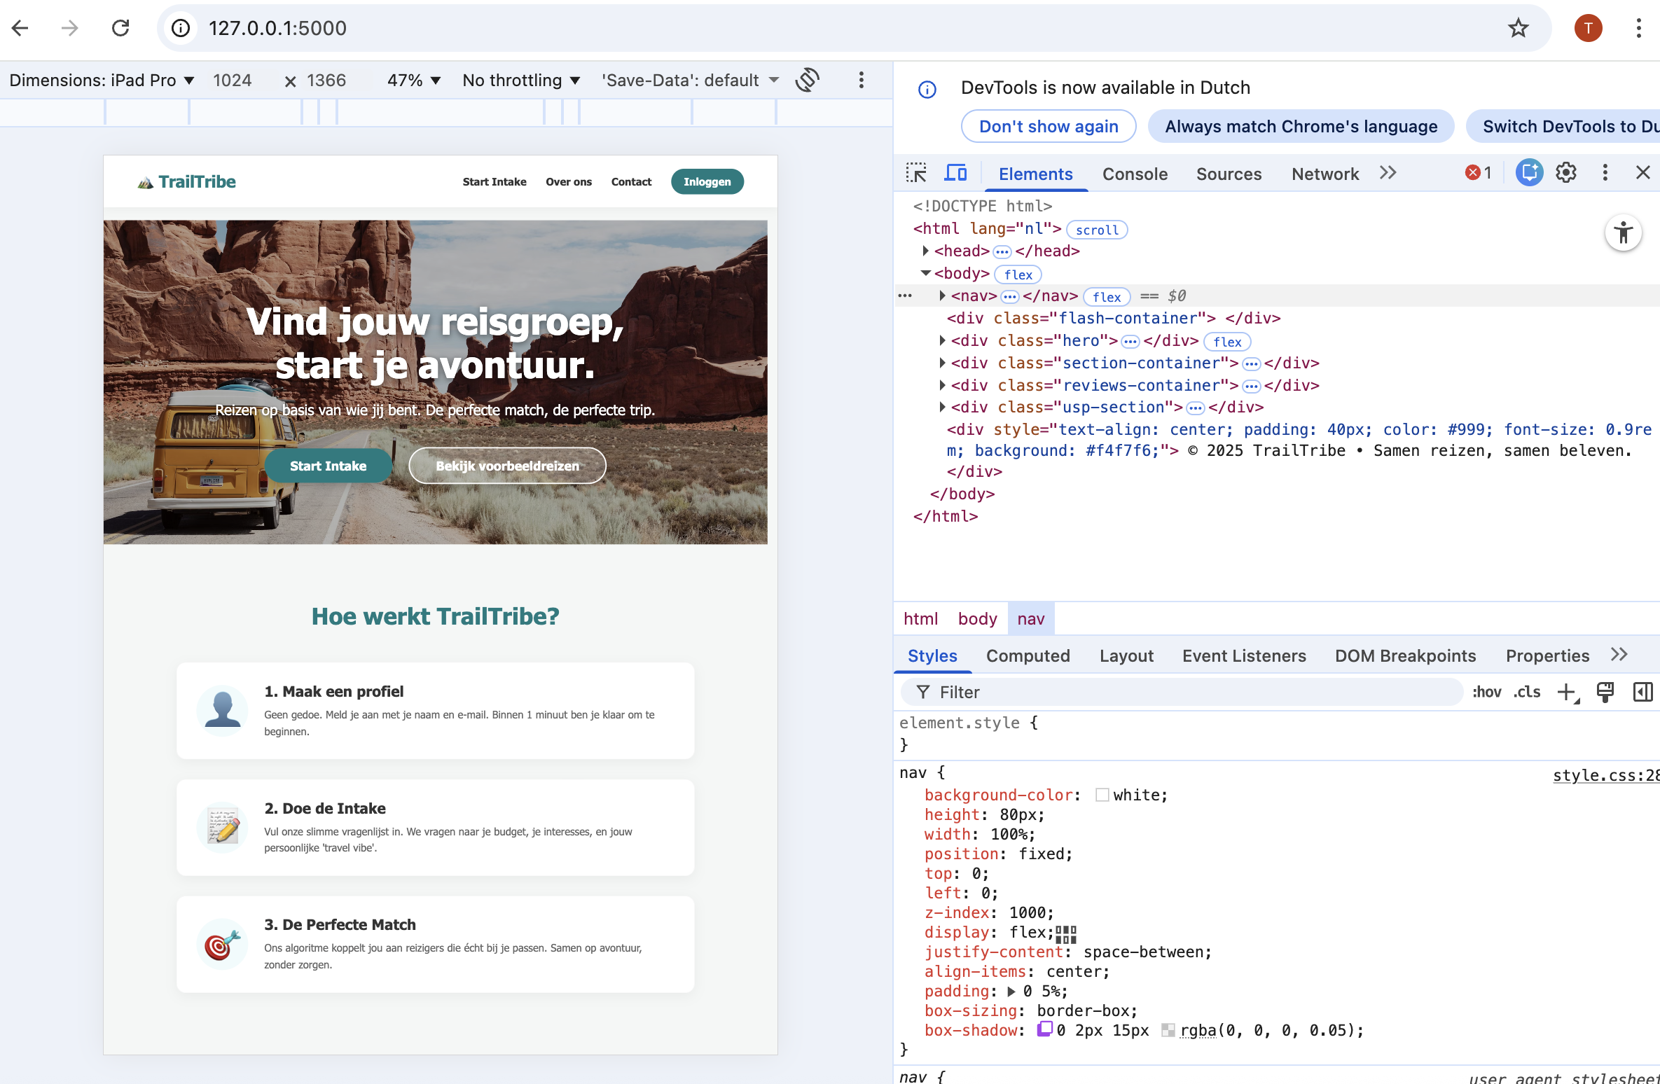
Responsive to Ipad and computer
OUR EXTRA FEATURES
As a User:
Add to Calendar (ICal)
Go with a Buddy
Notifications
Leave Group
Pay the advance
As an Organizer:
Add / delete a group (member)
Delete/ make travel offers
Look at everyones’ contact

Slide 9
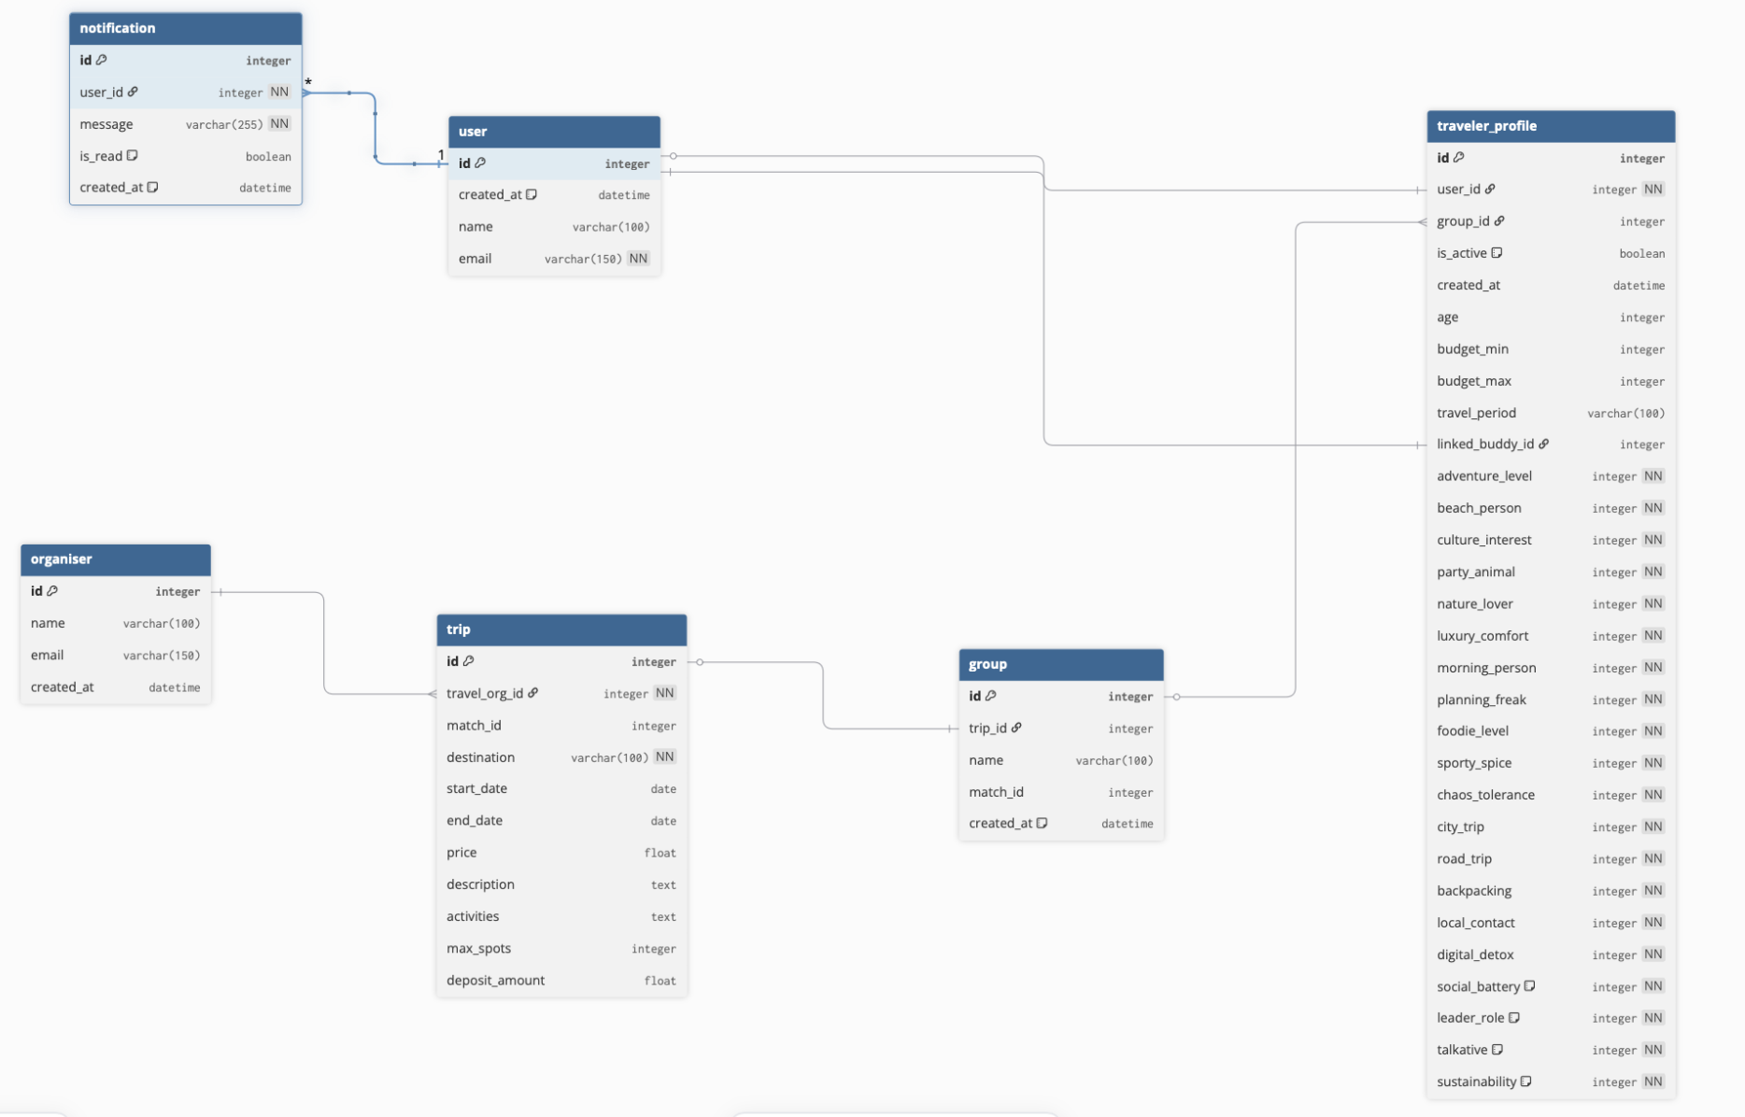
OUR ERD MODEL

Slide 10
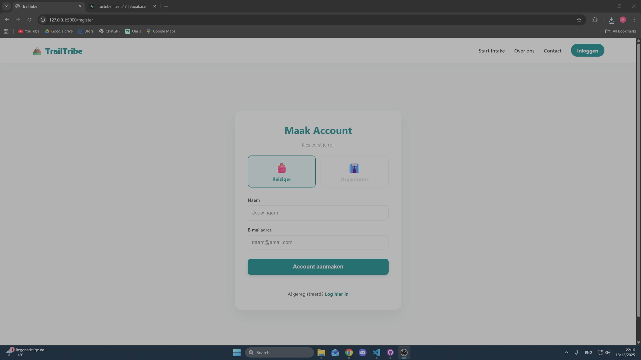
DEMONSTRATION

Slide 11
ANY QUESTIONS?

